Slide 1
Industrial Project - 234313 3D map evolution - PTC
Supervisors: Eldad Finkelstein, Mordecai Sayag
Students: Saja Yassin, Marwan Billan

Slide 2
Academic benefits
Learned about fundamental image processing algorithms:
Image coloring
Edge detection
Denoising
Segmentation
Features points detection such as SIFT and SURF
Feature matching such as: Brute force, knn match and Ransace

Slide 3
Achievements so far
Our algorithm in a nutshell:
divides the two images to equal rectangles
finds the similarity between each two rectangles from the same area
determines the classification according to a fixed threshold.

Slide 4
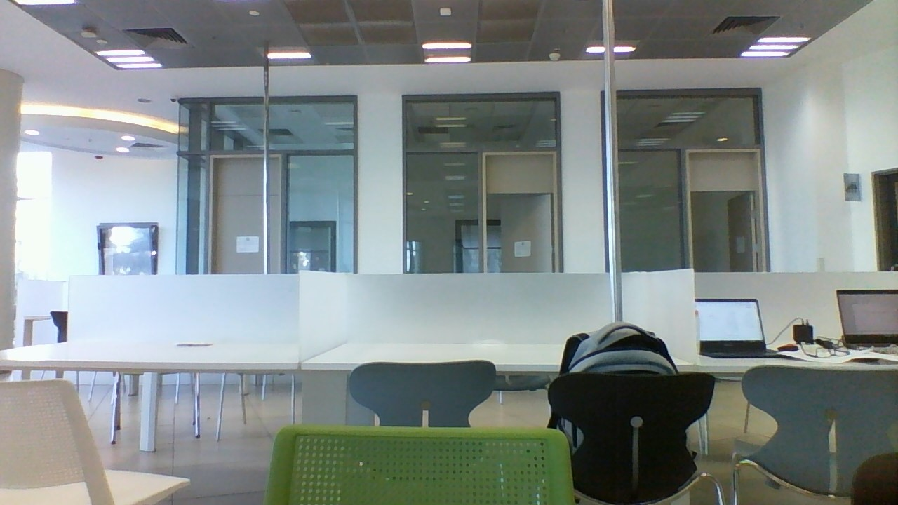
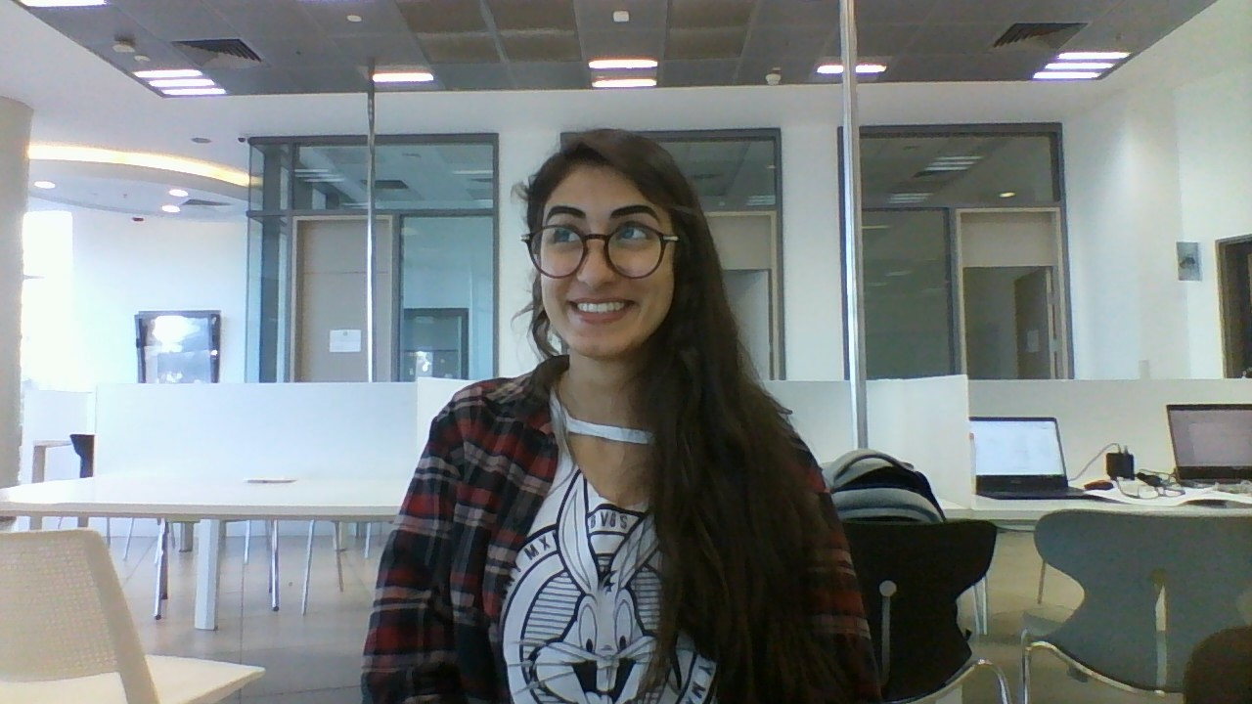
Example 1

Slide 5

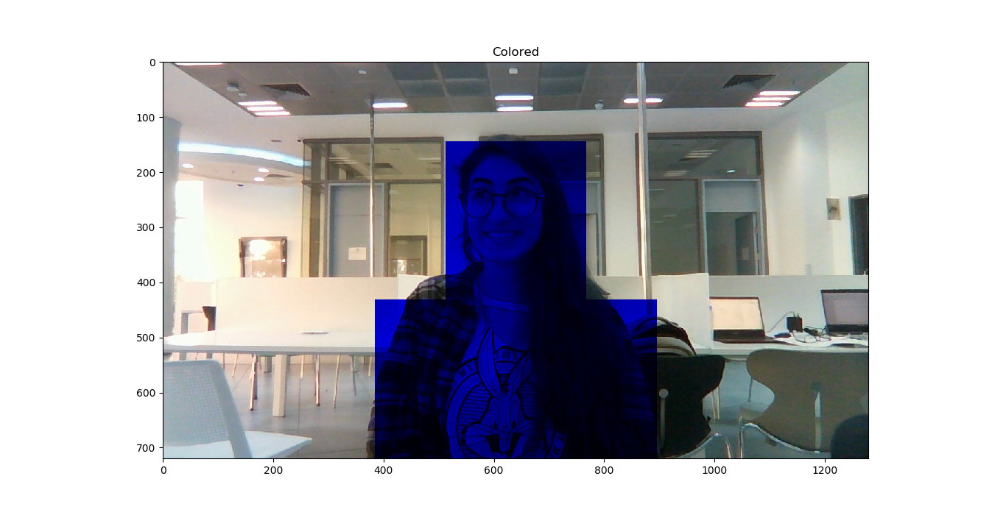

Slide 6
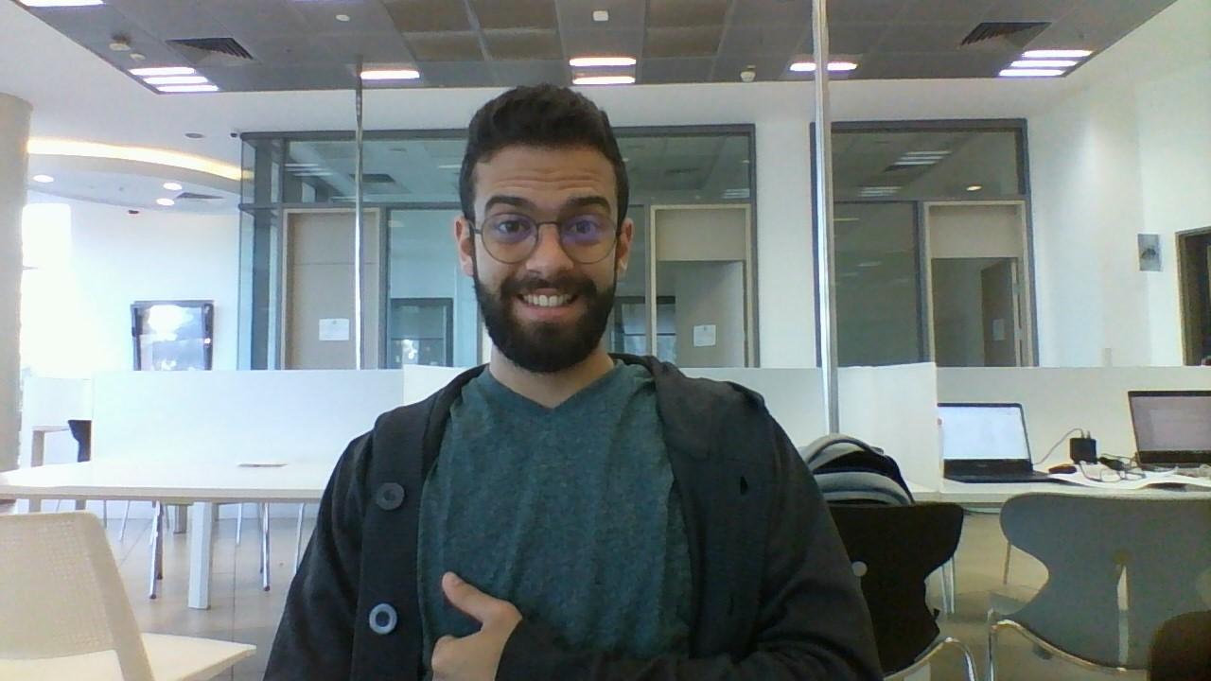
Example 2

Slide 7
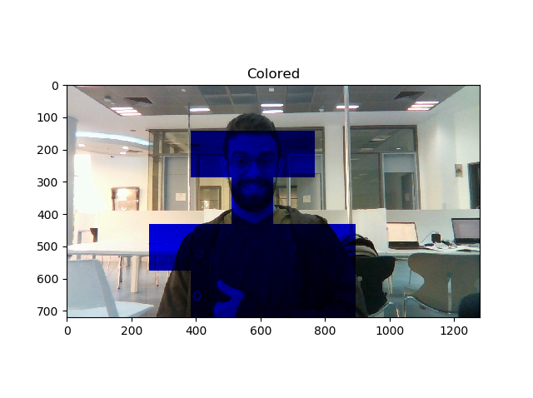

Slide 8
Obstacles
When the area we are examining does not have feature points in both the new and the old image, we can't determine whether there was a change or not.
When the area we are examining has many feature points of an unchanged objects, but the changed objects have very little feature points, our algorithm classifies it as unchanged (False Negative).

Slide 9
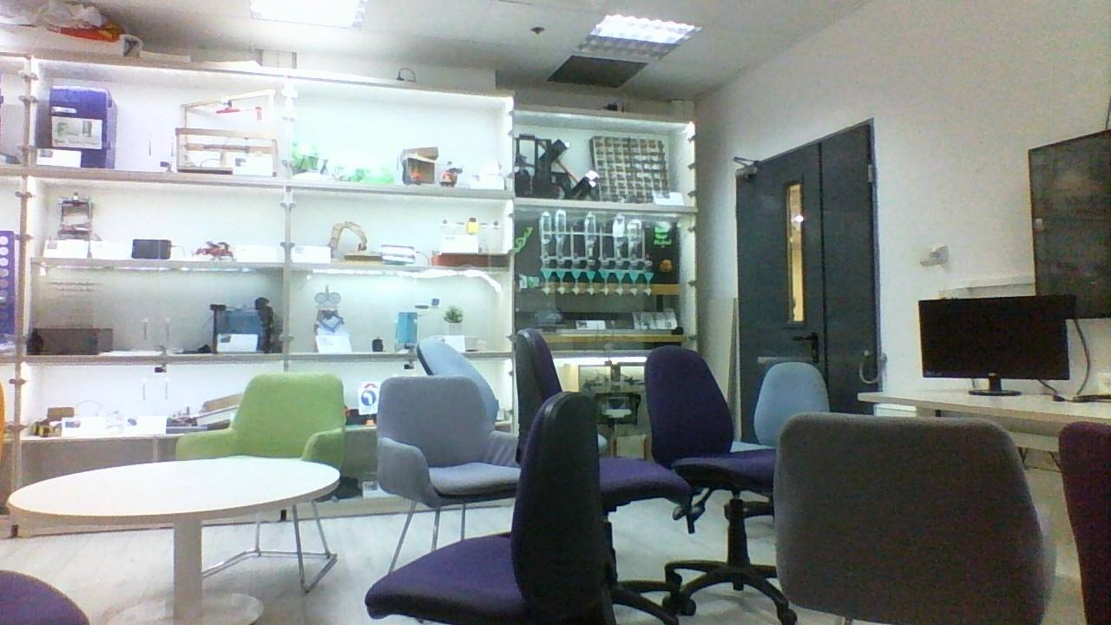
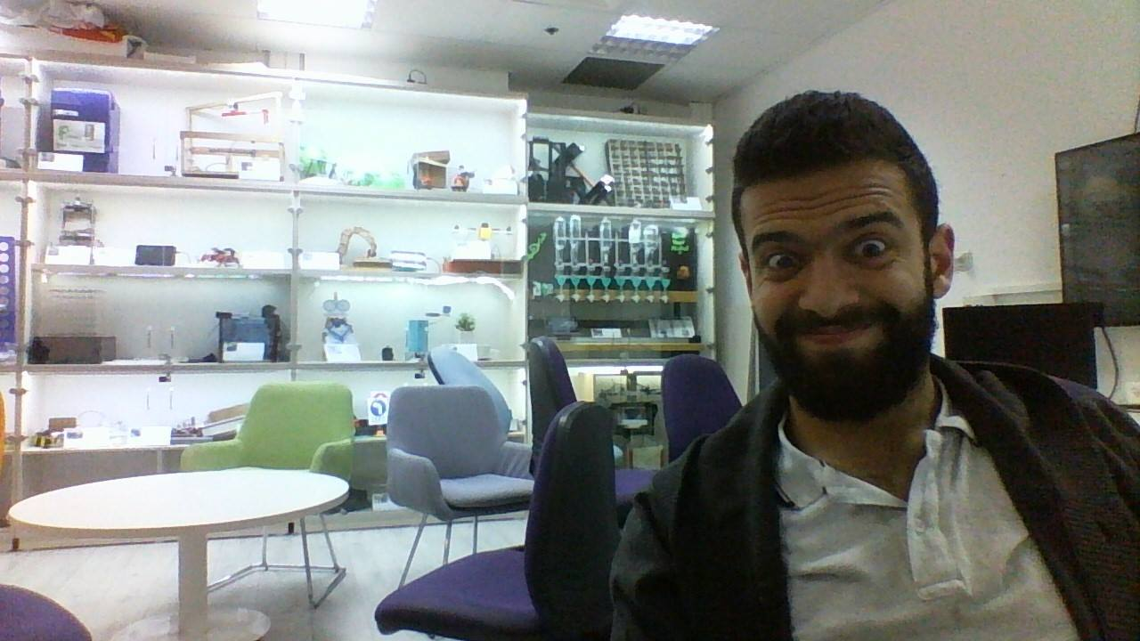
Example 3

Slide 10

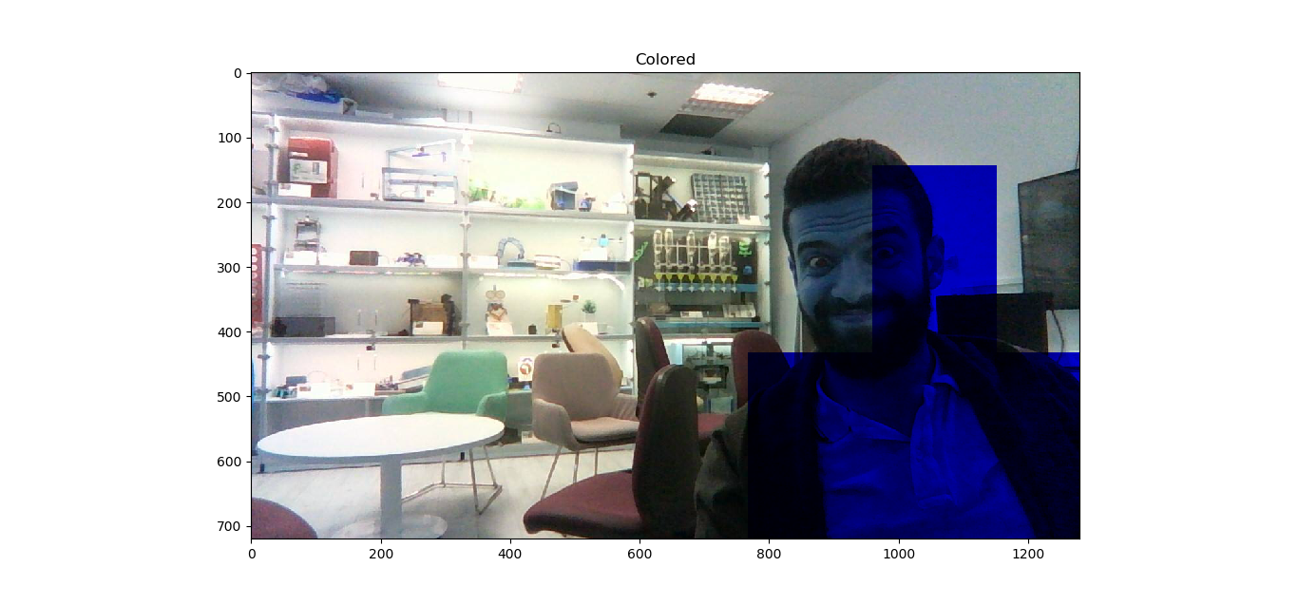

We can see here the second obstacle is reflected in the red circle.

Slide 11
What is to be done
Right now we are using a fixed parameters' values that suites the images we have. Tuning the parameters used in our algorithm to fit wider range of images.
Improving the algorithm while benchmarking over many different images in order to hit higher True classifications (we are ready to suffer from some False Positive while reducing the False Negative, e.g. example 2).
Supporting depth comparison.

Slide 12

Milestones
Preliminary Analysis (Week 3)
Getting acquainted with the industry needs, outlining the project roadmap and conducting a small research about the subject.
Analyze & Design (Week 8)
Fully understanding the system workflow and the interaction with the environment (input and output formats). Designing the program down to the class level.
Writing the code, debugging and minor testing.
Testing(Week 11)
Major testing and comparing different algorithms, fixing any bugs found in the whole program.
Finalizing (Week 13)
Fixing any bugs, more testing and improving the chosen algorithm.

